Slide 1
GROCERY WEBAPP
TEAM MEMBERS :-
NAMES NM ID
1. VAISHNAVI.S 85883882637D1BFAE064F87BCF1D724E
2. VARSHA.R S 210A698188BFB22AF0E47FD3ED2E3AAF
3. VARALAKSHIMI.S 4E27DA124C2C12389E54108DC2A9D035
4. VEDHA SRI.V CE669BEF7AD638394BD44E4014161D8C
5. VIJAYALAKSHIMI.D 88E3E73E5DBC22FBAC840E7CB812BDE0

Slide 2
ABSTRACT :
The Grocery Web App is a full-stack application built using the MERN stack designed to provide an efficient and user-friendly online shopping experience. Customers can seamlessly browse products across various categories, view detailed descriptions, add items to their cart, and securely complete transactions. The app emphasizes a smooth user experience, integrating intuitive navigation, responsive design, and real-time functionality. On the backend, it offers robust features for sellers, allowing them to manage product listings, inventory, and orders. Administrators have comprehensive control over customer inquiries, payment processing, and overall platform monitoring. The app ensures data security and privacy, using encryption for sensitive information and maintaining secure payment gateways. By leveraging the power of the MERN stack, the Grocery Web App provides a scalable and responsive solution for modern e-commerce, offering convenience to customers while enabling efficient management for sellers and administrators.
The front-end, developed with React, delivers a responsive and user-friendly interface, ensuring a seamless shopping experience. On the back-end, Node.js and Express.js manage the server-side logic, handling requests, user authentication, and secure transactions, while MongoDB serves as the database for storing product, user, and order information. The integration between the front-end and back-end is facilitated through RESTful APIs, enabling real-time communication and efficient data management, resulting in a highly functional and scalable online grocery platform.

Slide 3
INTRODUCTION :
Our basic grocery-web app! Our app is designed to provide a seamless online shopping experience for customers, making it convenient for them to explore and purchase a wide range of products. Whether you are a tech enthusiast, a fashionista, or a homemaker looking for everyday essentials, our app has something for everyone.
With user-friendly navigation and intuitive design, our grocery-webapp app allows customers to browse through various categories, view product details, add items to their cart, and securely complete the checkout process. We prioritize user satisfaction and aim to provide a smooth and hassle-free shopping experience.
For sellers and administrators, our app offers robust backend functionalities. Sellers can easily manage their product listings, inventory, and orders, while administrators can efficiently handle customer inquiries, process payments, and monitor overall app performance.
With a focus on security and privacy, our grocery-webapp app ensures that customer data is protected,
transactions are secure, and personal information remains confidential. We strive to build trust with our customers and provide a safe platform for online shopping.

Slide 4
PROPOSED SYSTEM:
User-Friendly Interface: Design a responsive and intuitive UI/UX for seamless navigation across all devices. Use a clear layout for categories, product listings, and easy search functionality.
User Registration & Authentication: Provide user registration with email or phone number, enabling users to create accounts, log in, and manage profiles. Implement secure authentication methods.
Product Listings & Categorization: Display products under relevant categories (fruits, vegetables, beverages, etc.) with details such as images, descriptions, prices, and availability.
Shopping Cart & Wishlist: Allow users to add, remove and view items to a shopping cart for immediate purchase or save items to a wishlist for future reference.
Search & Filtering Options: Enable users to search for specific products by name, category, or brand and apply filters for price range, availability, and offers.
Order Management & Tracking: Allow users to view order history, current orders, and real-time delivery tracking. Notify users of delivery status changes via SMS or email.
Payment Integration: Integrate multiple payment gateways (credit/debit cards, UPI, wallets, COD) for seamless and secure transactions. Ensure SSL encryption for safe payments.

Slide 5
Admin Dashboard: Build an admin interface to manage products, categories, user data, orders, inventory, and offers. Provide real-time data insights for decision-making.
Offers & Discounts: Implement promotional features like coupons, discounts on bulk orders, and seasonal offers to attract and retain customers.
Review & Feedback System: Allow users to rate products and leave feedback to enhance credibility. This will also help improve customer experience based on reviews.
Smart Recommendations: Use machine learning to provide personalized product recommendations based on user browsing and purchase history.
Real-time Inventory Management: Ensure that product availability is updated in real-time to prevent stockouts. Show alerts for out-of-stock items or low-stock warnings.
Delivery Scheduling & Time Slots: Allow users to select preferred delivery time slots and give options for express or same-day delivery.
Push Notifications & Alerts: Notify users via SMS, email, or app notifications about order confirmations, offers, stock availability, and delivery updates.

Slide 6
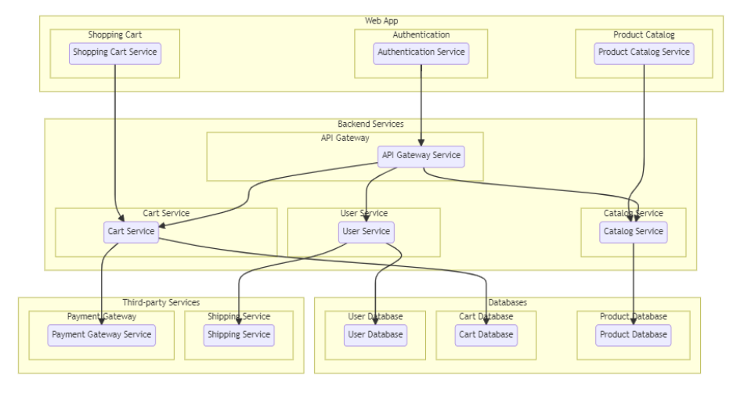
TECHNICAL ARCHITECTURE:

Slide 7
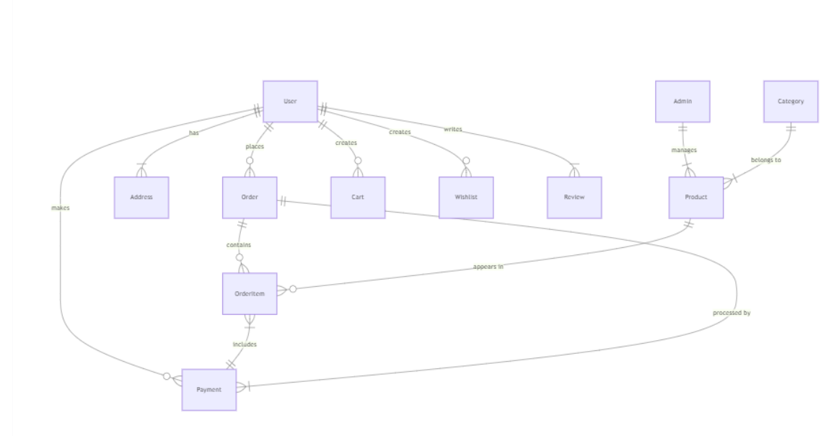
ER DIAGRAM:

Slide 8
FRONT-END , BACK-END DEVELOPMENT, INTEGRATION :
The front-end, developed HTML,CSS and React. With React, is responsible for the user interface (UI) and user experience (UX). It creates a dynamic, responsive, and interactive environment for users to browse, search for, and purchase grocery items. React's component-based architecture allows the UI to update in real-time, ensuring a fluid shopping experience. For example, users can add items to their cart, view product details, or filter items without reloading the page, thanks to React's virtual DOM and state management capabilities. React also communicates with the back-end through APIs, sending and receiving data asynchronously.
The back-end, powered by Node.js and Express.js, handles server-side logic, database interactions, and the processing of requests from the front-end. It is responsible for managing user authentication, handling payment processing, updating inventory, and ensuring secure data transfers. The back-end communicates with the MongoDB database to fetch product data, store user information, manage orders, and process transactions. Express.js, a web application framework, is used to set up RESTful API routes, defining how data is accessed and sent back to the front-end.
The integration of the front-end and back-end is achieved through RESTful APIs. The front-end React components make HTTP requests (typically using fetch or Axios) to the back-end API endpoints built with Express.js. These requests can include retrieving grocery items, submitting orders, or updating user profiles. The back-end processes these requests, interacts with the MongoDB database to retrieve or modify the necessary data, and sends the appropriate responses back to the front-end.

Slide 9
WORKING MODEL

Slide 10
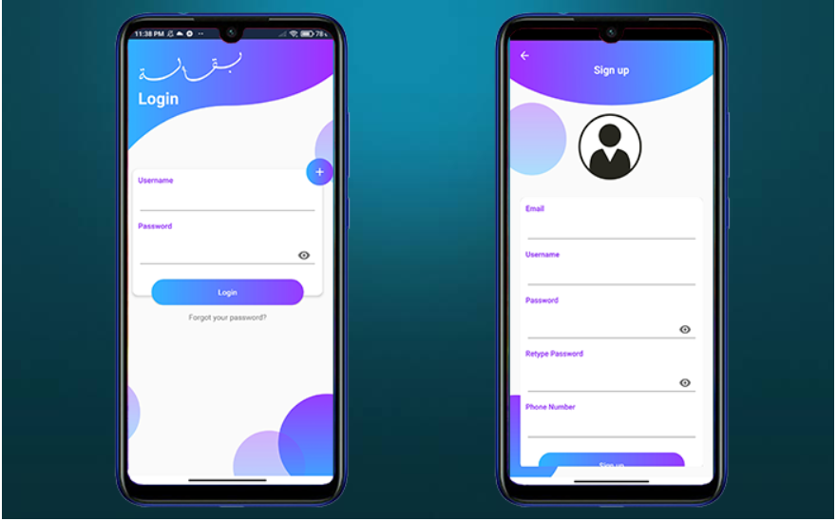

Slide 11
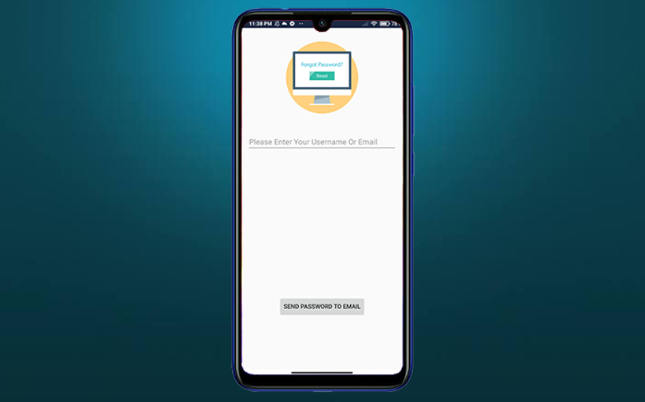

Slide 12
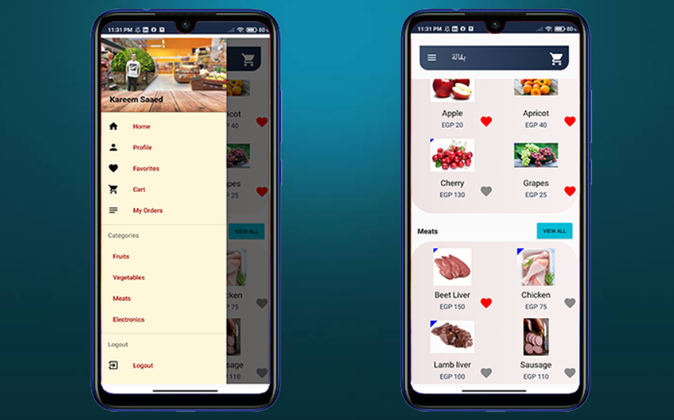

Slide 13
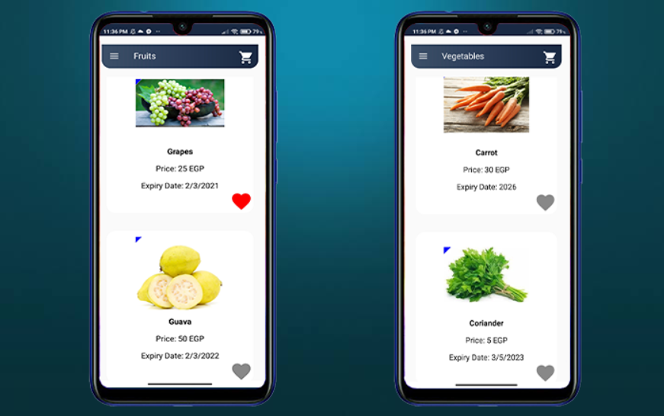

Slide 14
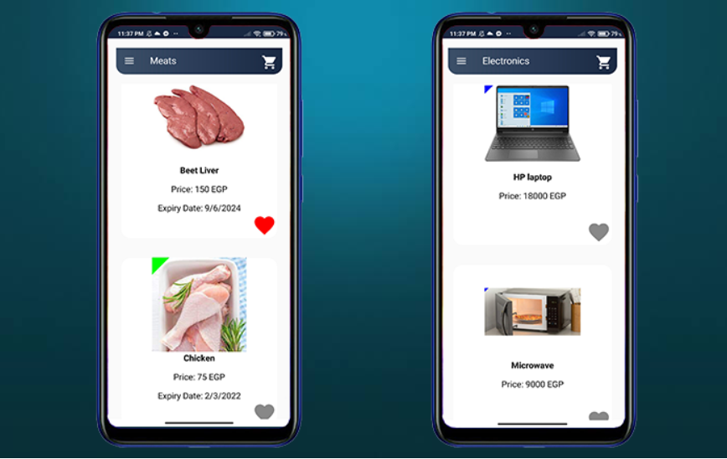

Slide 15
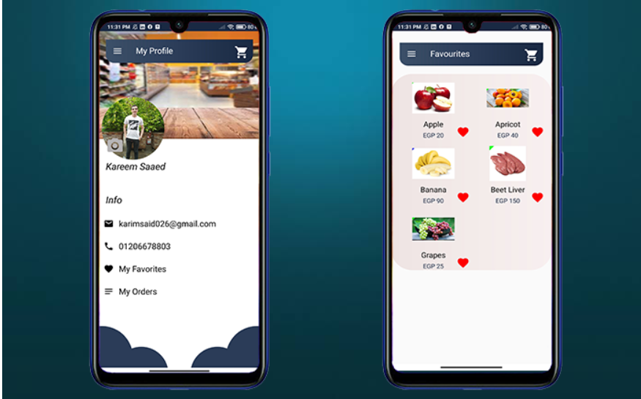

Slide 16
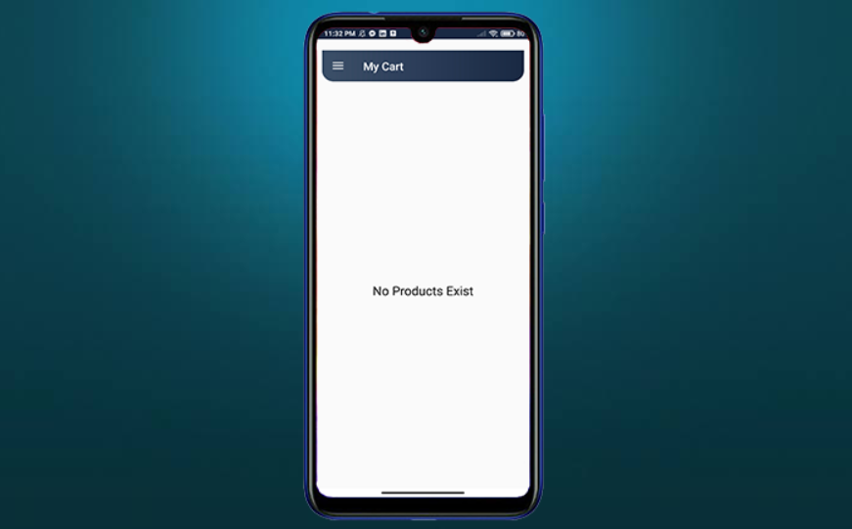

Slide 17
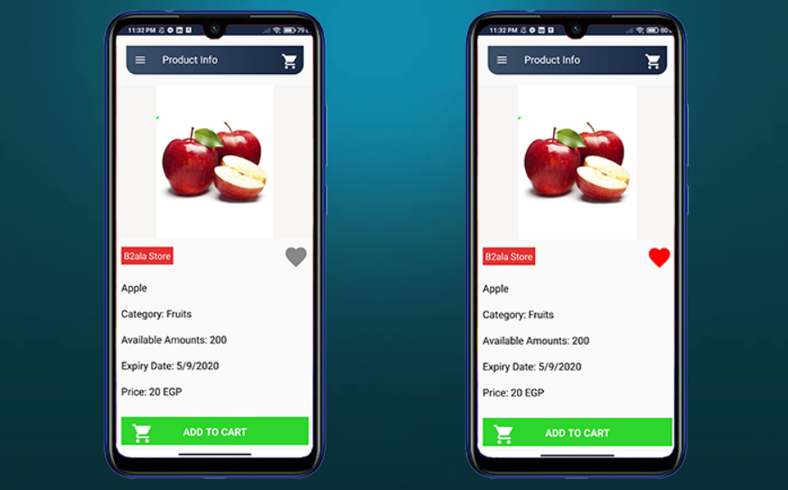

Slide 18
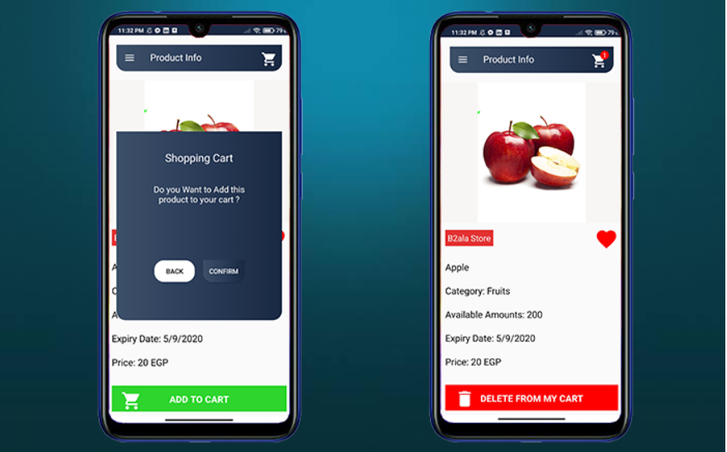

Slide 19
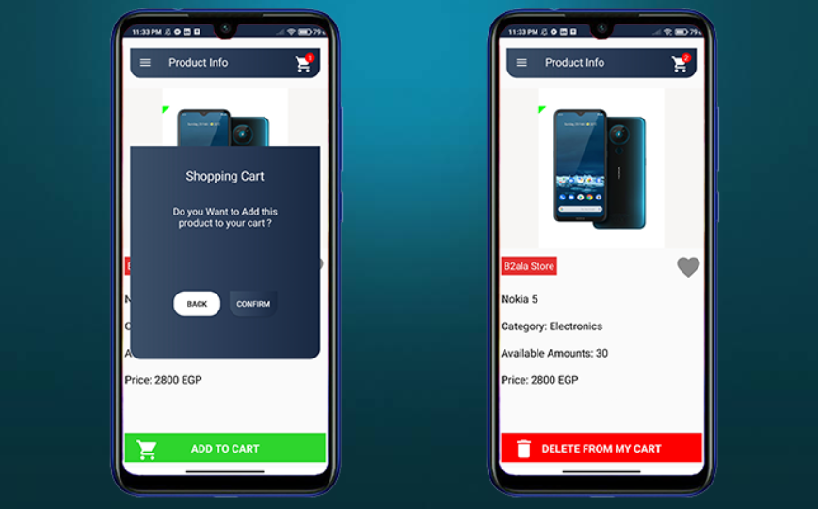

Slide 20
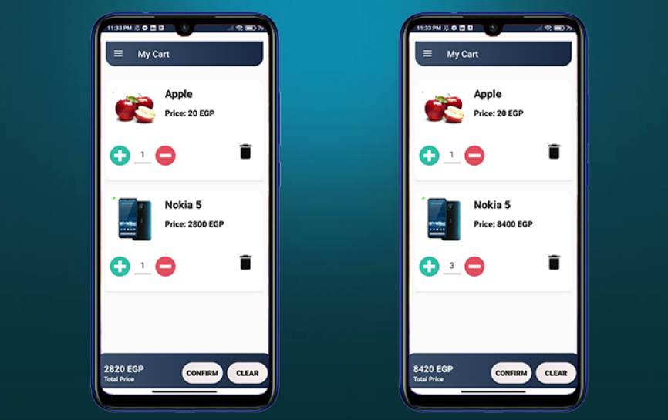

Slide 21
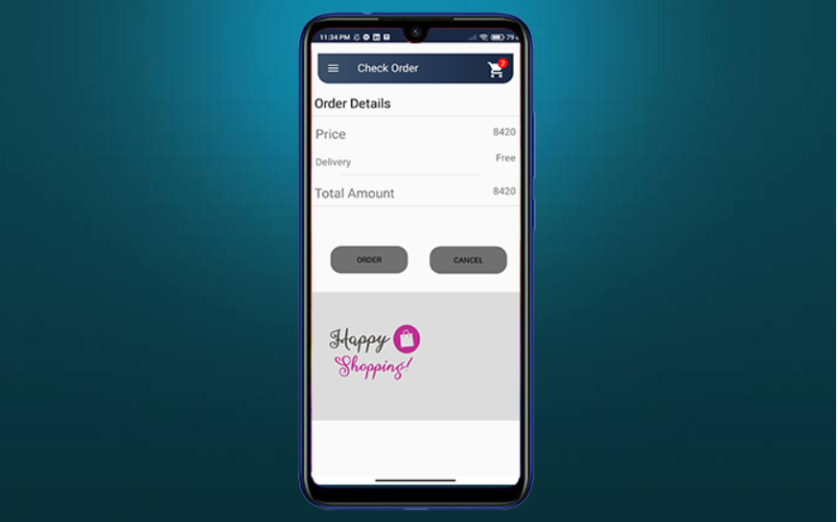

Slide 22
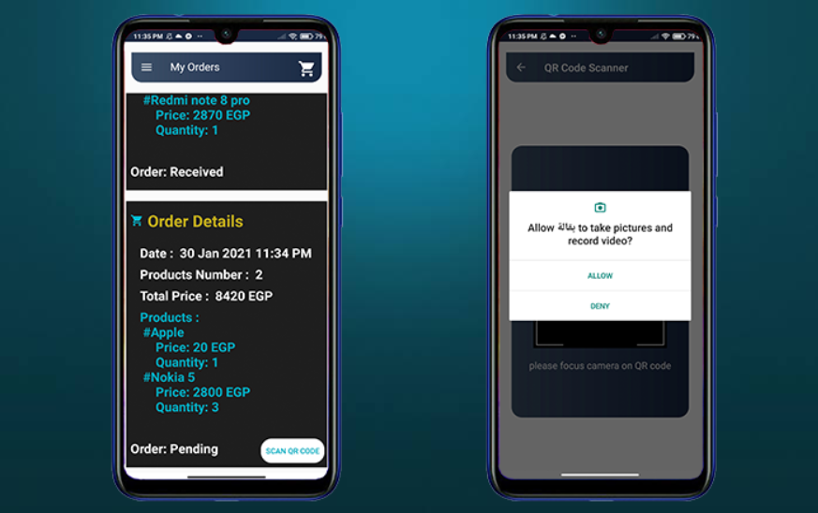

Slide 23
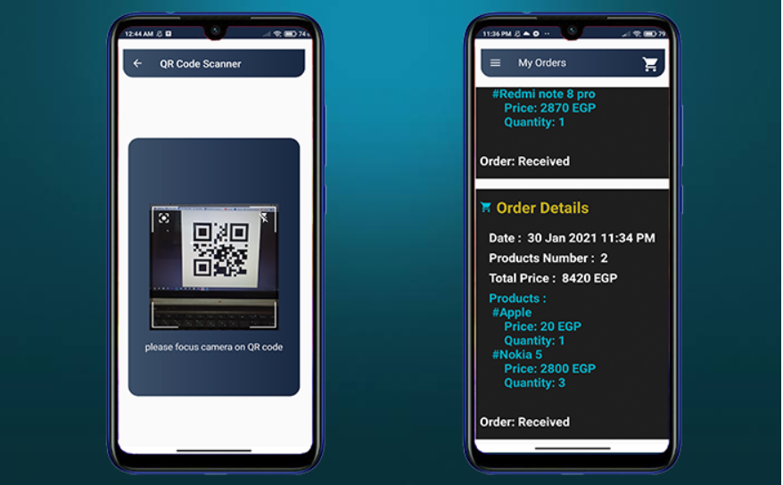

Slide 24
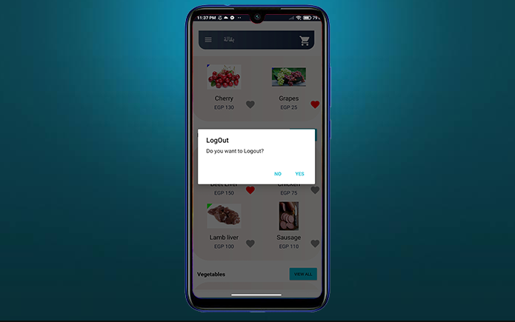

Slide 25
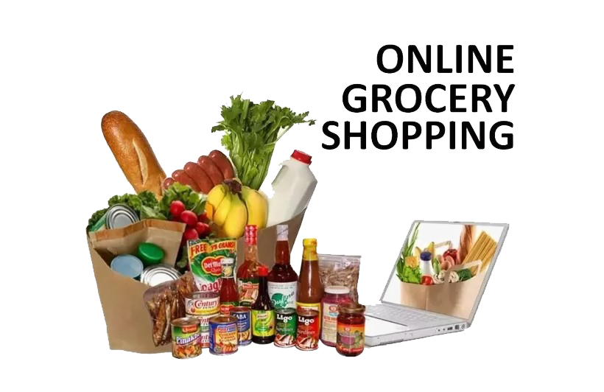
CONCLUSION:
In conclusion, our grocery webapp has been developed with the goal of transforming the grocery shopping experience for our users. By combining intuitive design with essential features, we provide a platform that simplifies the entire shopping process.
Our app offers:
User-Friendly Interface
Personalized Recommendations
Real-Time Inventory Updates
Seamless Checkout Process
This Photo by Unknown Author is licensed under CC BY-NC

Slide 26
THANK YOU !

